Slide 1
An Introduction to RFgen Mobile Foundations for JD Edwards EnterpriseOne
Presented by:
Sales Consultant

Slide 2
Agenda
What are the Challenges?
RFgen Software Overview
[Prospect Name]’s Business Challenge
RFgen Mobile Foundations for Oracle’s JD Edwards EnterpriseOne
The Wireless Warehouse
How to Achieve 24/7 Continuous Operation
Voice-Enabling Your JD Edwards Warehouse
Real World Results – A Few Customer Case Studies
Q&A

Slide 3
8 Challenges Solved with a Mobile Data Collection Solution
Growing Business
Margin Pressure
Government Regulations
Value from IT
Traceability
Accuracy
Scalability
Customer Service
Notes:
Growing Business
Your business is growing and needs to increase throughput to keep from having to develop or purchase more facilities.
Margin Pressure
Margin pressure from competitive market forces and increased costs is causing pressures to look for savings throughout the business.
Government Regulations
Faced with changing and expanding regulatory requirements, you need to ensure compliance with ePedigree requirements, maintain tracking of lot/batch/country of origin, comply with FDA Bioterrorism Act requirements and more.
Value from IT
You want to get more output from you existing IT infrastructure – without putting day-to-day operations at risk.
Traceability
You are being asked to support the Produce Traceability Initiative (PTI) to ensure complete produce traceability and support GS1 standards.
Accuracy
Providing more “perfect orders” is a top objective in enhancing customer service. To achieve this, you need to offer solutions for improving shipment accuracy and timeliness of delivery.
Scalability
You’re evaluating processes to keep pace with the growth of your online business and find a solution to address the line item order fulfillment business amid a changing mix of product shipments.
Customer Service
Your business continues to look for ways to provide competitive differentiators and customer service offerings.

Slide 4

Paper-Based and Manual Processes Create Inefficiencies

Slide 5

It also Makes it Difficult to Get Real-Time Visibility into Inventory

Slide 6
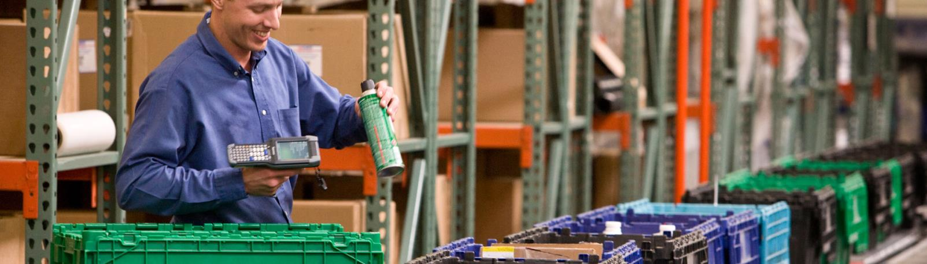
What You Need are Barcode and Mobile Solutions to Track Inventory in Real-Time

Slide 7
RFgen Software Overview

Slide 8

Who is RFgen Software?
Established in 1983
Oracle-Validated Integration
Global Reach
JD Edwards EnterpriseOne XE to 9.1
2,800 worldwide installations
140 partners worldwide
Regional support in 35+ countries
Total Solution Provider
Certified Partner
Software
Hardware
Professional Services
Oracle Gold Partner
Deltek Premier Partner
SAP Partner
JD Edwards World A7.3 to A9.3

Slide 9
RFgen Mobilizes the Supply Chain
Integrated ERP Solutions
JD Edwards
Supply Chain Accelerators
And More
Industry Solutions
Aerospace & Defense
SAP
SAP Business One
Deltek Costpoint
And More
Warehouse Automation
Voice Picking
Remote Warehouse Automation
Feed, Food & Beverage
Life Sciences
Oil & Gas
Retail
CPG
Engineering, Construction & Industrial Supplies
High Technology
Industrial Machinery & Equipment
And More
Asset Management
Barcode Labeling
Inventory Management
Field Service
License Plating
Oracle E-Business Suite
Shop Floor Data Collection

Slide 10



The RFgen Mobile Framework
RFgen Software designs, implements and deploys mobile and wireless software, and open source supply chain solutions for automated data collection.
Barcoding
Voice
Roaming
Mobile

Slide 11
Where is RFgen Used?
Inside the Four Walls
Outside the Four Walls
Inventory Management
Warehouse Automation
Voice-Directed Operations
Manufacturing Operations
Field Service
Freight Yard Operations
Remote Inventory Management
Direct Store Deliver
Transportation and Logistics
Track and Trace

Slide 12








































































































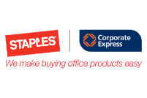










2,800+ Sites | 25+ Industries | 35+ Countries
Aerospace & Defense
Automotive
Consumer Packaged Goods
Electronics
Engineering & Construction
Feed, Food & Beverage
High Technology
Industrial Machine & Equipment
Life Sciences
Manufacturing
Oil & Gas
Pharmaceutical
Retail
Transportation & Logistics
Utilities & Energy

Slide 13
RFgen Mobile Foundations For Oracle’s JD Edwards EnterpriseOne

Slide 14
RFgen Mobile Foundations for Oracle’s JD Edwards EnterpriseOne
Mobile Application Development Platform
Certified Connectivity with Oracle’s JD Edwards EnterpriseOne
Out-of-the-Box Pre-Written Pre-Tested Mobile Apps
Open Source Architecture Facilitates Rapid Modification and Configuration
Supports Multiple Data Capture Scenarios for Real-time, Mobile and Batch Workflows

Slide 15

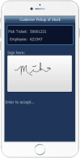
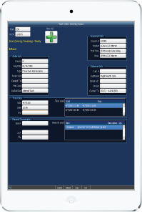

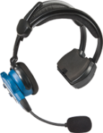
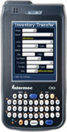
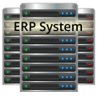
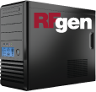

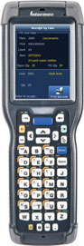
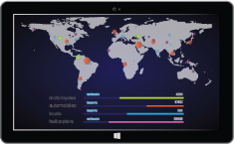
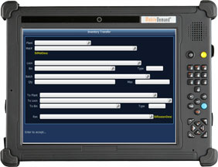
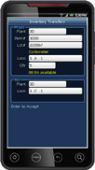
RFgen-JDE Integration at a Glance
JD Edwards
Devices
Business Logic Integration
JDE Business Functions
Data Integration
Business Data
Configuration Options
Real-Time Data Validation

Slide 16
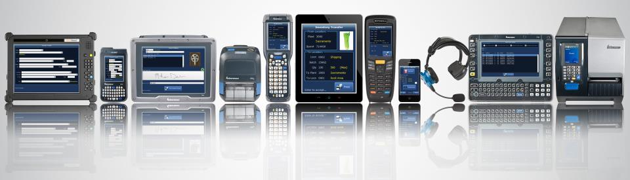
RFgen Extends JD Edwards to Any Data Collection Device Type
Operating Systems
Windows Mobile and CE
Android
iOS
Telnet
Data Collection Devices
Barcode Scanners
Tablets and Smartphones
Vehicle Mount Computers
Voice Recognition
RFID
And More
Machine-to-Machine (M2M)
Carousels and Scales
Sensors
Meters
Robots
And more
Notes:
RFgen can not only work with Android and iOS devices, but we also work with older technologies using Windows Mobile, Windows CE, and Telnet.
We haven’t run into any device RFgen couldn’t run on, but if we do we will get that device running at no charge.

Slide 17
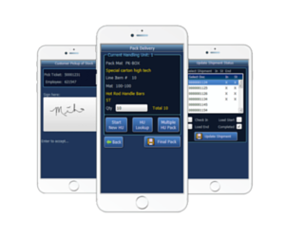
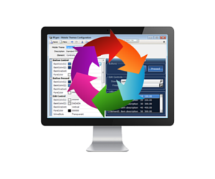
RFgen Framework for JD Edwards
Pre-Built Mobile Application Suite
Certified and pre-tested mobile applications
RFgen Mobile Development Studio
Drag and drop visual environment
Integrate with other shop floor systems
Change pre-built mobile apps or build new ones
Implement out of the box or customize
Built using data collection best practices

Slide 18
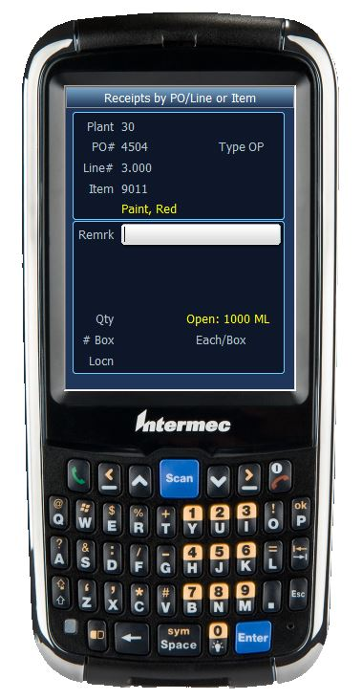
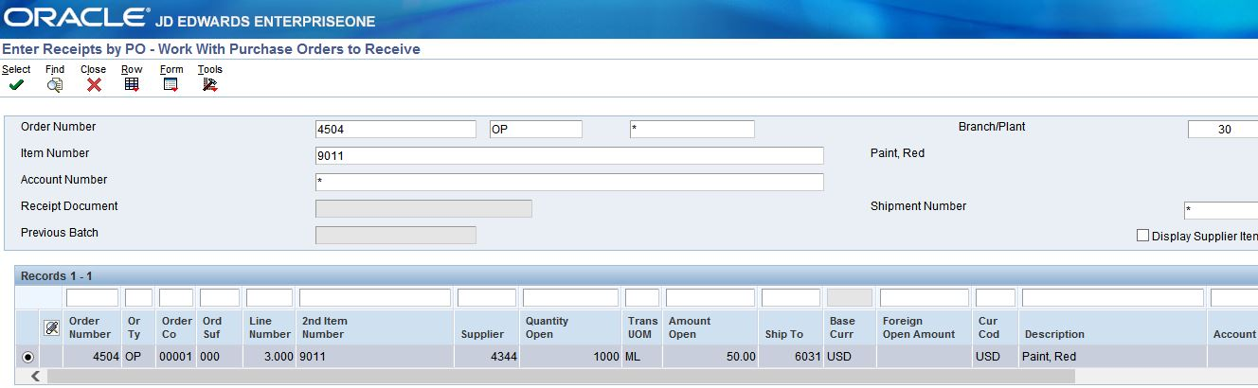
RFgen-JD Edwards Integration
RFgen on a Mobile Device
JD Edwards EnterpriseOne Screen
All data is validated against business data in JD Edwards.
All transactions are executed using JD Edwards business functions.

Slide 19
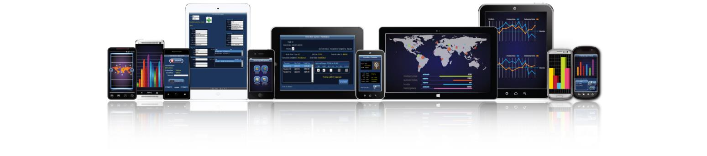
Pre-Built JD Edwards Mobile Apps Included
CUSTOMIZE AND CREATE YOUR OWN MOBILE APPS!
Equipment & Plant Maintenance
Fixed Assets
Inventory Management
License Plating
Manufacturing
Order Management
Purchasing
Warehouse Management

Slide 20
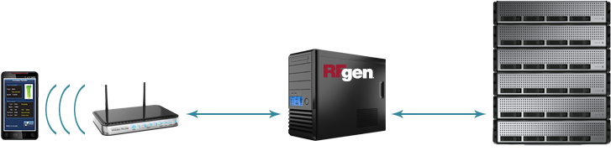
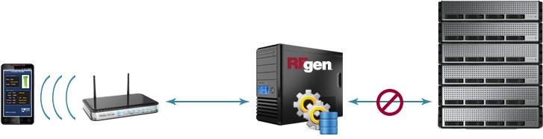

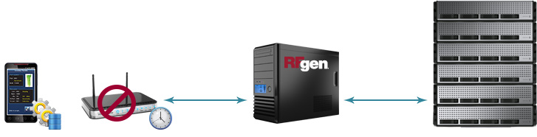
RFgen Connectivity Scenarios
Real-Time
High Availability
Offline Mobility

Slide 21
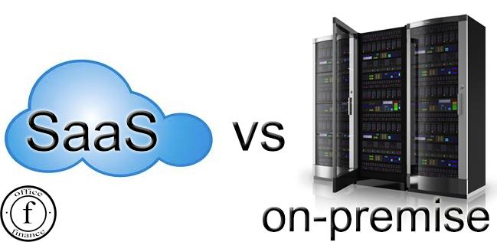

Deployment Options
Onsite use license
Eliminates privacy and security concerns
No capital expenditure
Annual payments
Minimizes internal IT requirements to deploy and manage
Run RFgen in your IT infrastructure
Maintain complete control of your entire RFgen platform
Manage complex data, analytics, or big data sets including networks, analysis, image services, or real-time sensor streams

Slide 22

Zero Footprint on JD Edwards Means Hassle-Free JDE Upgrades
Nothing to Reinstall
The RFgen version is the same regardless of the JD Edwards version.
RFgen Can Reduce Custom Modifications
Move custom modifications from JD Edwards to RFgen.
RFgen is Non-Invasive
Simply redirect RFgen to the new environment and begin UAT.
No custom objects within JD Edwards to upgrade or retrofit.
Eliminates the need to retrofit.

Slide 23

RFgen Implements in Weeks, Not Months
Open Source Code Samples
Rapid Application Development Platform
No Cryptic Scripting Language
Uses Data Dictionary Aliases
Reusable Objects
Interactive Debugger
Built-in SQL Testing
Deploys Instantly to All Devices
Notes:
RFgen is simple to implement. Typical implementation time is 4-6 weeks.

Slide 24
The Wireless Warehouse

Slide 25

RFgen provides real-time, wireless connectivity to a wide range of systems and supports numerous warehouse operations like:
Inventory management
Receiving
Picking, packing and shipping
Manufacturing
Quality assurance
Time and attendance
Wireless and Mobile Data Collection

Slide 26


Case Study
Company:
Industry:
Application:
Environment:
Simmons Pet Foods (formerly Menu Foods)
Pet Food Manufacturing
Food Traceability, Inventory Control, P O Processing, Manufacturing, License Plating, High Availability
JD Edwards EnterpriseOne 8.10
The RFgen Solution:
Provided real time integration for supply chain operations.
Increased traceability and shipment tracking efficiencies.
Implemented License Plating between warehouses.
Improved overall operational efficiencies.
A leading private-label and contract manufacturer of pet food products sold by supermarket retailers, mass merchandisers, pet specialty retailers and other outlets – 17 of the top 20 North American retailers.
Notes:
Read the case study at: http://www.rfgen.com/jde-barcode-software-case-study-menu-foods/

Slide 27
How to Achieve 24/7 Continuous Operation

Slide 28

RFgen provides the ability to continue operating 24/7, even when the host system is unavailable.
Remote and off-shore locations
Poor/occasional connectivity
Disconnected environments
Nightly/weekly back-ups
100% transaction visibility
High Availability Disconnected Solutions

Slide 29

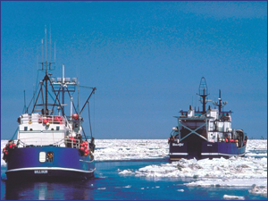
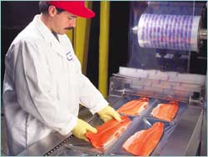
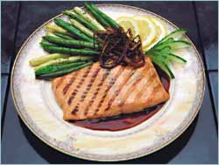
Case Study
Company:
Industry:
Application:
Environment:
Trident Seafoods
Food Manufacturer
Food Traceability, Inventory Control, License Plating, High Availability, P O Processing, Manufacturing
JD Edwards EnterpriseOne 9.1
The RFgen Solution:
Allowed for operations regardless of JDE availability.
Provided real-time visibility of inventory movement.
Eliminated manual paperwork, reducing errors.
Supported lot traceability throughout the supply chain.
7000 transactions per day.
Trident Seafoods is the largest seafood company in the United States. It manages a network of fishing ships, processing plants, and a vertically integrated distributorship of its products.
Notes:
Read the case study at: http://www.rfgen.com/jde-barcode-software-case-study-trident/

Slide 30

RFgen supports mobile on-demand access to your data from any Windows, Android or iOS device.
Vendor managed inventory
Product returns
Drop ship
Proof of delivery
Direct store delivery (DSD)
Field service/sales
Batch (fields, yards, freezers, etc.)
On-Demand Enterprise Mobility

Slide 31


Case Study
Company:
Industry:
Application:
Environment:
Chateau Ste. Michelle Winery
Alcoholic Beverages
Manufacturing, Inventory Control, SO Processing, License Plating, Off-Network Mobility, High-Availability
JD Edwards World A7.3
The RFgen Solution:
Implemented barrel tracking improving visibility.
Provided automated data collection of products.
Manufacturing transactions used to complete finish goods.
Utilized the RFgen high availability and mobility features in wine cellar.
Chateau Ste. Michelle is Washington state's oldest and most acclaimed winery located near Seattle. The winery ships over two million cases of wine per year.
Notes:
Read the case study at: http://www.rfgen.com/jde-barcode-software-case-study-ste-michelle/

Slide 32
Voice-Enabling Your JD Edwards Warehouse

Slide 33

Hands-Free, Eyes-Free Warehouse Operations
The RFgen-Vocollect Voice Solution provides hands-free, eyes-free warehouse operations, helping you achieve:
10-25+% productivity gains
Up to 99.99% accuracy
Improved safety
Increased job satisfaction
Reduced training costs

Slide 34

What is Voice-Directed Work?
Perform step-by-step tasks and collect data using voice prompts and worker voice responses.
Wireless technology with direct integration into back-end systems.
Hands-free, eyes-free.
Designed for noisy, industrial environments and diverse users.
Focused on order selection/picking.
Expandable to other applications: fork lifts, line loading, cycle counting, put-to-store and more.
Notes:
34
34

Slide 35
Voice Provides Real-World Results
Voice-Enabled Picking
>20% improvement in productivity
Voice-Enabled Put Away and Replenishment
20% increase in productivity while increasing volume
Voice-Enabled Loading
Voice-Enabled Receiving
Up to 99.95% order accuracy
50% reduction in training time
52% improvement in replenishment rate (pallet/hr)
67% reduction in training time
>20% increase in productivity while increasing volume
Reduced floor space—doors turn faster
Eliminated double-check by a supervisor before receiving is complete
Allowed use of labor standards with data capture

Slide 36


Case Study
Company:
Industry:
Application:
Environment:
Caito Foods
Produce Distribution
Food Traceability, PO Processing, License Plating
Inventory Management, SO Processing, Voice Picking
JD Edwards EnterpriseOne 8.XE (upgrading to 9.1)
The RFgen Solution:
License plating improved traceability and enabled full field-to-fork GTIN tracking and the delivery of country of origin information to customers.
RFgen audit trail enables them to easily pass government audits.
Voice technology helps prevent cross-contamination and expedites picking and shipping.
Improved efficiency in receiving, put away and inventory replenishment processes.
Founded in 1965, Caito Foods operates four distribution centers that send fresh produce to multiple states in the Eastern, Midwestern and Southeastern United States.
Notes:
Read the case study at: http://www.rfgen.com/jde-barcode-software-case-study-caito-foods/
Notes from interview with IT manager:
It’s now easy to pass an audit using RFgen – RFgen gives us an audit trail
We can now comply with regulations
Country of origin tracking
Different County of Origins can be consolidated to one item instead of 15 scans – reduces it down to 1 with license plating
GTIN# sent attaches to item and to the field – links to vendor and field – enables field-to-fork traceability
If there is a recall, GTIN will link back to the field where the product came from
PTI = Produce tracking initiative
Prevent cross-contamination with allergens
Verify that organics stay where they are supposed to be
IP transfer
Moving
Trace and give customers an invoice
RFgen enables you to customize the system to eliminate steps
Very flexible to change and get it up and running
Easy to modify
Eliminates errors that were found
Put in check points along the way
Complete visibility of where products are at at all times from receiving to shipping
Make you more efficient
Most important! It integrated into ERP linking everything into the financial and accounting information

Slide 37
RFgen is a Total Solutions Provider
RFgen
Software
Hardware
Professional Services
Support
Oracle-validated integration with JD Edwards
Hundreds of pre-built mobile apps
Mobile development studio for fast and easy application development
24/7 technical phone support
24/7 online support and resources
Classroom and online training
Certified reseller of major mobile device and hardware brands
Windows, Apple iOS and Android
Single vendor accountability
ERP integration expertise
Mobility and automation expertise
Supply chain and industry expertise

Slide 38
How [Prospect] Wins with RFgen
A solution for right now
Implement an Oracle-validated solution for JD Edwards EnterpriseOne that will meet your organizations exact needs for automated data capture today.
A solution that will evolve with you
Integrate multiple (disparate) systems and multiple ERP systems.
Integrate with third-party inventory management solutions.
Integrate with multi-carrier shipping and automated equipment.
Add new workflows, new product lines and new facilities.
Achieve a low total cost of ownership and quick ROI.
Administer one single-source platform for all your mobility and automation needs.
Manage and maintain one platform with minimal effort.
Easily upgrade your front-end systems when you upgrade your JD Edwards EnterpriseOne system.
A solution that provides value

Slide 39
Questions?
Contact
call | TBD
email | TBD
visit | TBD

Slide 40
Other Slides

Slide 41
The Advantages of Automation
Mobile Data Validation and Processing Against JD Edwards EnterpriseOne
Multiple options to meet your requirements:
Endless Mobile Worker Possibilities
Proof of delivery signature capture
Direct connect
Connect-on-demand
Batch on- and off-line (hybrid solutions)
Mobile field service
Sales order creation
Asset tracking/warranty tracking
Automation of Warehouse Activities
Eliminates manual processes
Increases data accuracy
Increases employee productivity
Real-time data validation and processing
Notes:
If you have a mobile workforce, RFgen’s mobile data validation and processing against JD Edwards gives you multiple options to meet your requirements including:
Direct connect, where you have a direct connection to your RFgen server via a 3G/4G device or smart phone.
Connect on demand, which allows you to collect transactions in a disconnected mode and then send those transactions to the RFgen server at your convenience.
Batch on and offline, which is a hybrid of direct connect and connect on demand.
There are endless mobile worker possibilities. Things like:
Proof of delivery signature capture, where you might have your own delivery fleet.
Mobile field service that allows you to track your parts inventory and transact against repair or service orders.
Sales order creation and customer service applications for your mobile sales force.
Asset tracking and warranty tracking for assets that may be in offsite locations.

Slide 42
Mobile Data Collection by the Numbers
Faster Training
Increase in Productivity
Increase in Efficiency
Increase in Accuracy
99%
25%
30%
80%

Slide 43
How is RFgen Different than a WMS?
WMS
Typically a combination of a desktop and handheld application.
A separate system with its own separate database.
Requires data synchronization between the ERP and WMS, which requires some management because you have two separate databases.
RFgen
An add-on mobile data collection software solution to the ERP.
Does not require a separate database because it processes transactions in real-time against the ERP.
A system that extends the functionality of the ERP onto a mobile device.
Typically has its own set of business rules and configuration that must be set up and managed.
A solution that utilizes the data and business rules already setup in the ERP.

Slide 44

RFgen’s JD Edwards Consulting Team Core Competencies
Senior level consulting expertise in business processes for JD Edwards EnterpriseOne and JD Edwards World.
Extensive knowledge of industry-specific best practices for automated data capture and warehouse management solutions.
Real-world, hands-on experience with multiple data capture technologies and process workflows.
Ability to plan, prepare, design, and deploy solutions that deliver desired results.

Slide 45

Around the Clock Technical Support
RFgen technical support experts are on-hand 24 hours a day, seven days a week.
Toll-free number gives you instant access to an RFgen technical expert, ready to help you get your applications back up and running.
For non-urgent issues, submit an online help request or search the RFgen Online Knowledgebase.
Join the RFgen LinkedIn User Community and gain access to others using RFgen.

Slide 46
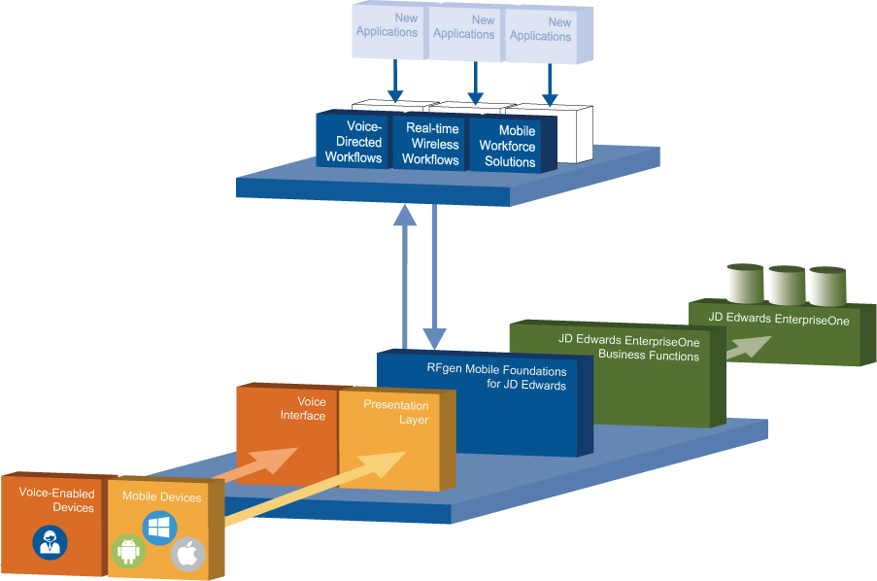
RFgen System Architecture

Slide 47
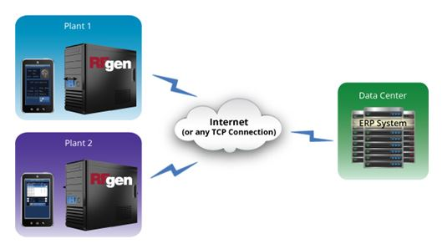
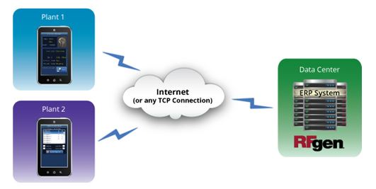
RFgen Architecture On-Premise
RFgen On-Premise
Scenario 1
RFgen On-Premise
Scenario 2

Slide 48
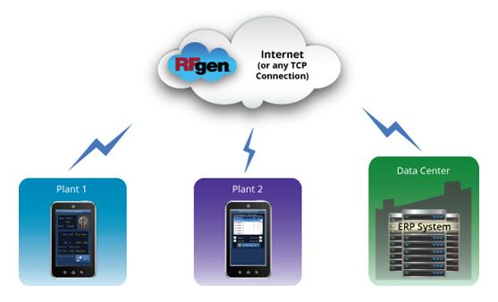
RFgen Architecture In the Cloud
RFgen in the Cloud

Slide 49
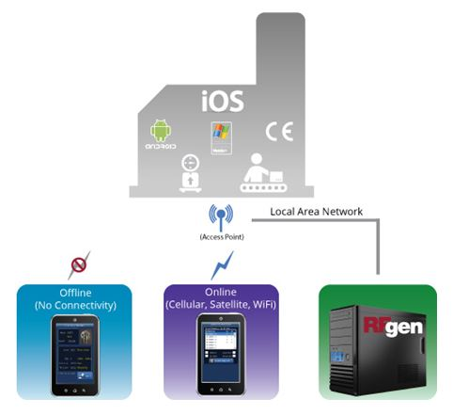
RFgen Connectivity Scenarios
RFgen in or Near the Plant

Slide 50
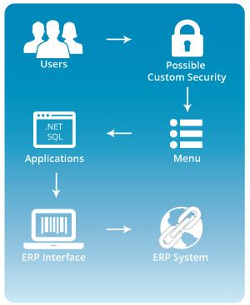
RFgen Application Framework

Slide 51
[Prospect Name]’s Business Challenge

Slide 52

[Prospect Name]’s Business Challenge
Briefly describe the prospect’s business challenge
Text
Text
Text

Slide 53

[Prospect Name]’s Expected Project Deliverables
Briefly outline what they hope to get by automating
Text
Text
Text

Slide 54



[Prospect Name]’s Requirements
Requirement | RFgen Meets Requirement
Text
Text
Text

Slide 55

How will RFgen Meet all of Your Requirements?
The flexibility and robustness of the RFgen Mobile Framework enables us to meet all of [Prospect Name]’s requirement for warehouse automation and mobility.
Let’s take a look at RFgen Mobile Foundations for JD Edwards EnterpriseOne.

Slide 56
Summary of Your RFgen Project
Turn-key solution for warehouse automation for the workflows listed to the right.
Meets the unique or specific requirements of each of the four distribution centers.
If there are other areas where efficiencies can be created we can incorporate them into this project very easily.
This solution can provide a mobile field sales application for your 250+ field reps.
Create increased efficiency / throughput
Reduction of direct labor
Increased inventory accuracy
eliminate manual processes and data entry
RFgen is very flexible and scalable
Transactions Includes in RFgen Solution
RFgen Distribution Suite
Cycle Count
PO Receipt by PO/Line
RFgen Warehouse Management
Warehouse Director
Put Away by Item
RFgen License Plate Suite
Create Entity
Assign Entity
Create LP Type
Create Plate
Attach Plate
Detach Item
Transfer LP
Pick, Pack, Ship (Outbound)
Pick to Plate
Ship Confirm Plate / Load
RFgen Inquiries
Item/Location Inquiry
Location Inquiry
Supply/Demand Inquiry
PO Inquiry by Item / Line

Slide 57
Improving Traceability and Efficiency with License Plating

Slide 58

What is License Plating?
A license plate distinguish a container with a unique serial or ID number. It can include a barcode that itemizes attributes such as:
Quantity
Inventory status
Location
Lot number
Creation date
Change date
And more

Slide 59
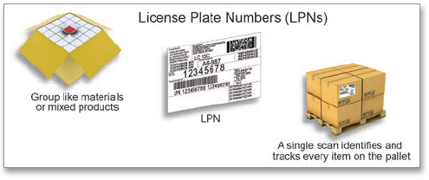
Why RFgen License Plating?
Features
Inventory staging for:
Manufacturing
Outbound Orders
Warehouse-to-Warehouse Transfers
Hold and release inventory by pallet
Load management
Shipping documents
Advance Ship Notice (ASN)
UCC-128 labeling
Track/trace history
Benefits
Allows the ability to completely identify goods in transactions such as receive, move, production, or shipping.
Substantially reduces the number of scans necessary to enter a transaction.
Seamlessly integrates with an ERP’s manufacturing and distribution process.

Slide 60
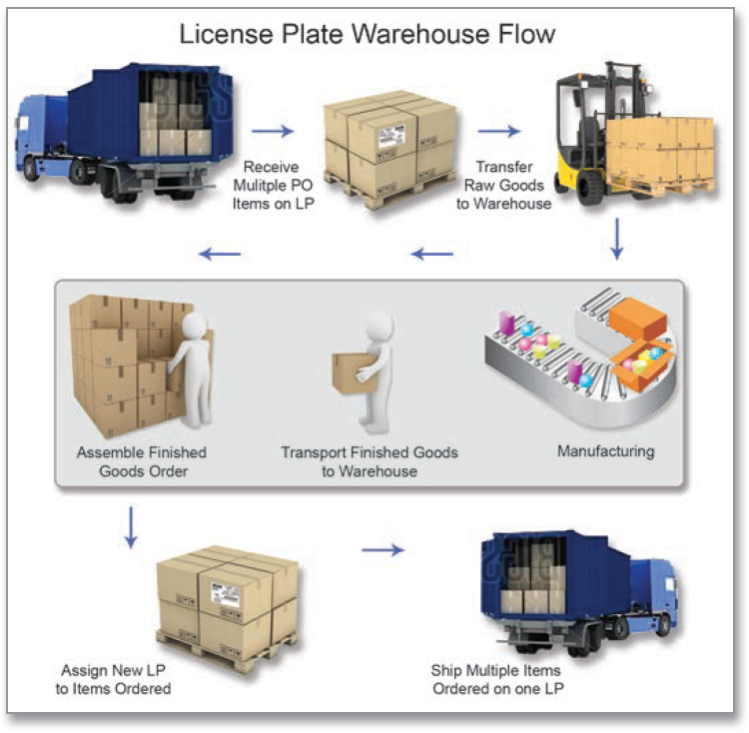

Slide 61
Getting WMS Benefits at a Fraction of the Cost with RFgen Warehouse Director

Slide 62
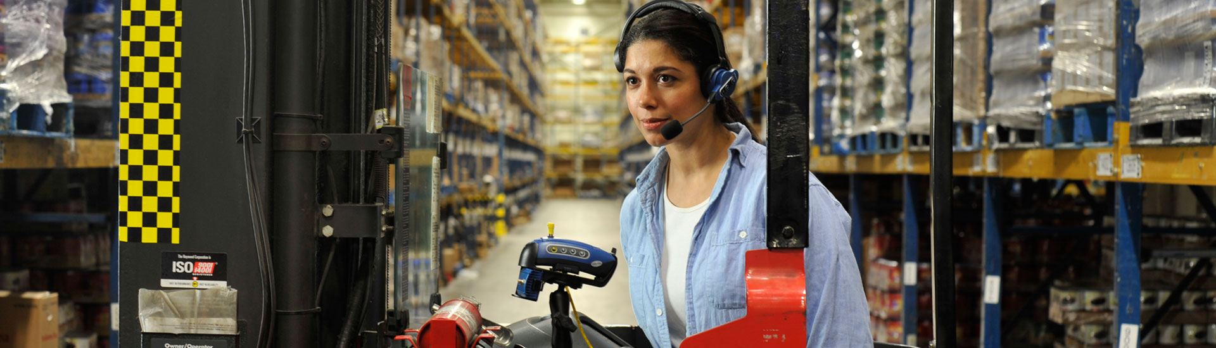
What is RFgen Warehouse Director?
A warehouse management tool that is powered by the RFgen Mobile Framework.
Based on the host inventory, it directs warehouse workers to complete inventory movement tasks such as put away, picking and replenishment.
The host inventory can be anything including JD Edwards EnterpriseOne and World, or a variety of other ERP solutions.
Notes:
62
62

Slide 63
What Does it Do?
A key indicator can be an inventory receipt that needs to be put away, a sales order that is ready for picking, or a replenishment of a location that has fallen below the minimum inventory level.
Once a warehouse job is created, it automatically appears on the warehouse workers mobile device.
Following the direction of the warehouse job, the worker picks up inventory from the source location and moves it to the suggested destination location.
Once the movement is completed, the warehouse job automatically disappears from the device display and the worker moves onto the next open job.
Reads key indicators within the host environment to create warehouse jobs.

Slide 64


RFgen Warehouse Director
ERP System
RFgen Warehouse Director
Devices
Put Away
Pick
Reple-nish
Warehouse Jobs
JD Edwards
Oracle EBS
SAP
Deltek Costpoint
Directed Put Away
Directed Picking
Directed Replenishment

Slide 65

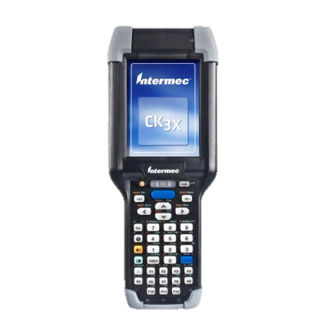
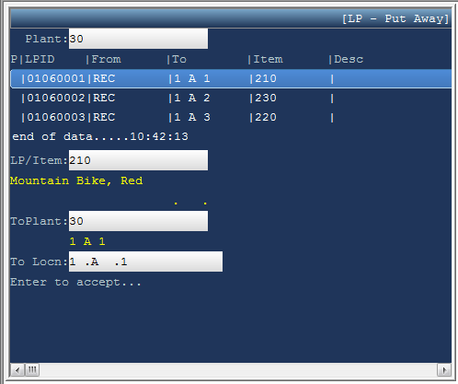
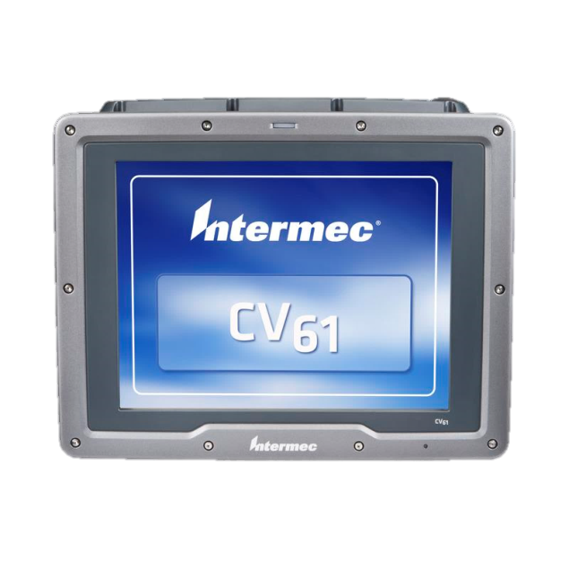
Directed Put Away Directed Replenishment

Slide 66

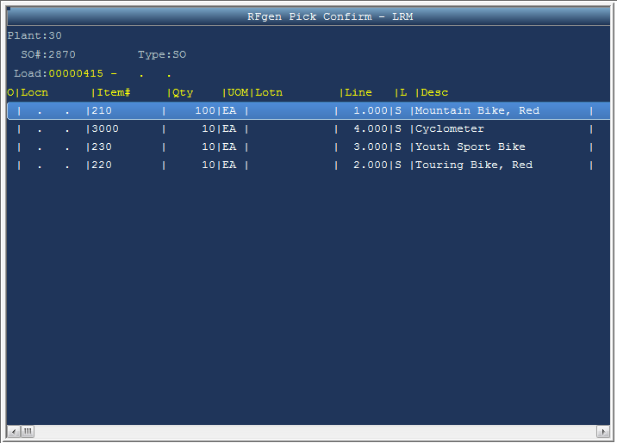
Directed Picking

Slide 67

Feature Comparison
Warehouse Management Features | RFgen Warehouse Director | JD Edwards Advanced Warehousing
Directed Outbound Picking
Directed Work Order Picking
Directed Put Away
Directed Replenishment
Suggestion Oriented
Hard-Rule Oriented
Pending Job Electronic Notification
Warehouse Space Management
Rapid Implementation

Slide 68
RFgen License Plating and Warehouse Director Considerations
You do not need JD Edwards Advanced Warehousing or the Transportation Module to use RFgen license plating or warehouse director functionality.
With other vendors, you will have to install these modules in JD Edwards to get similar functionality.
This is a huge benefit and cost savings for you.

